Slide 1
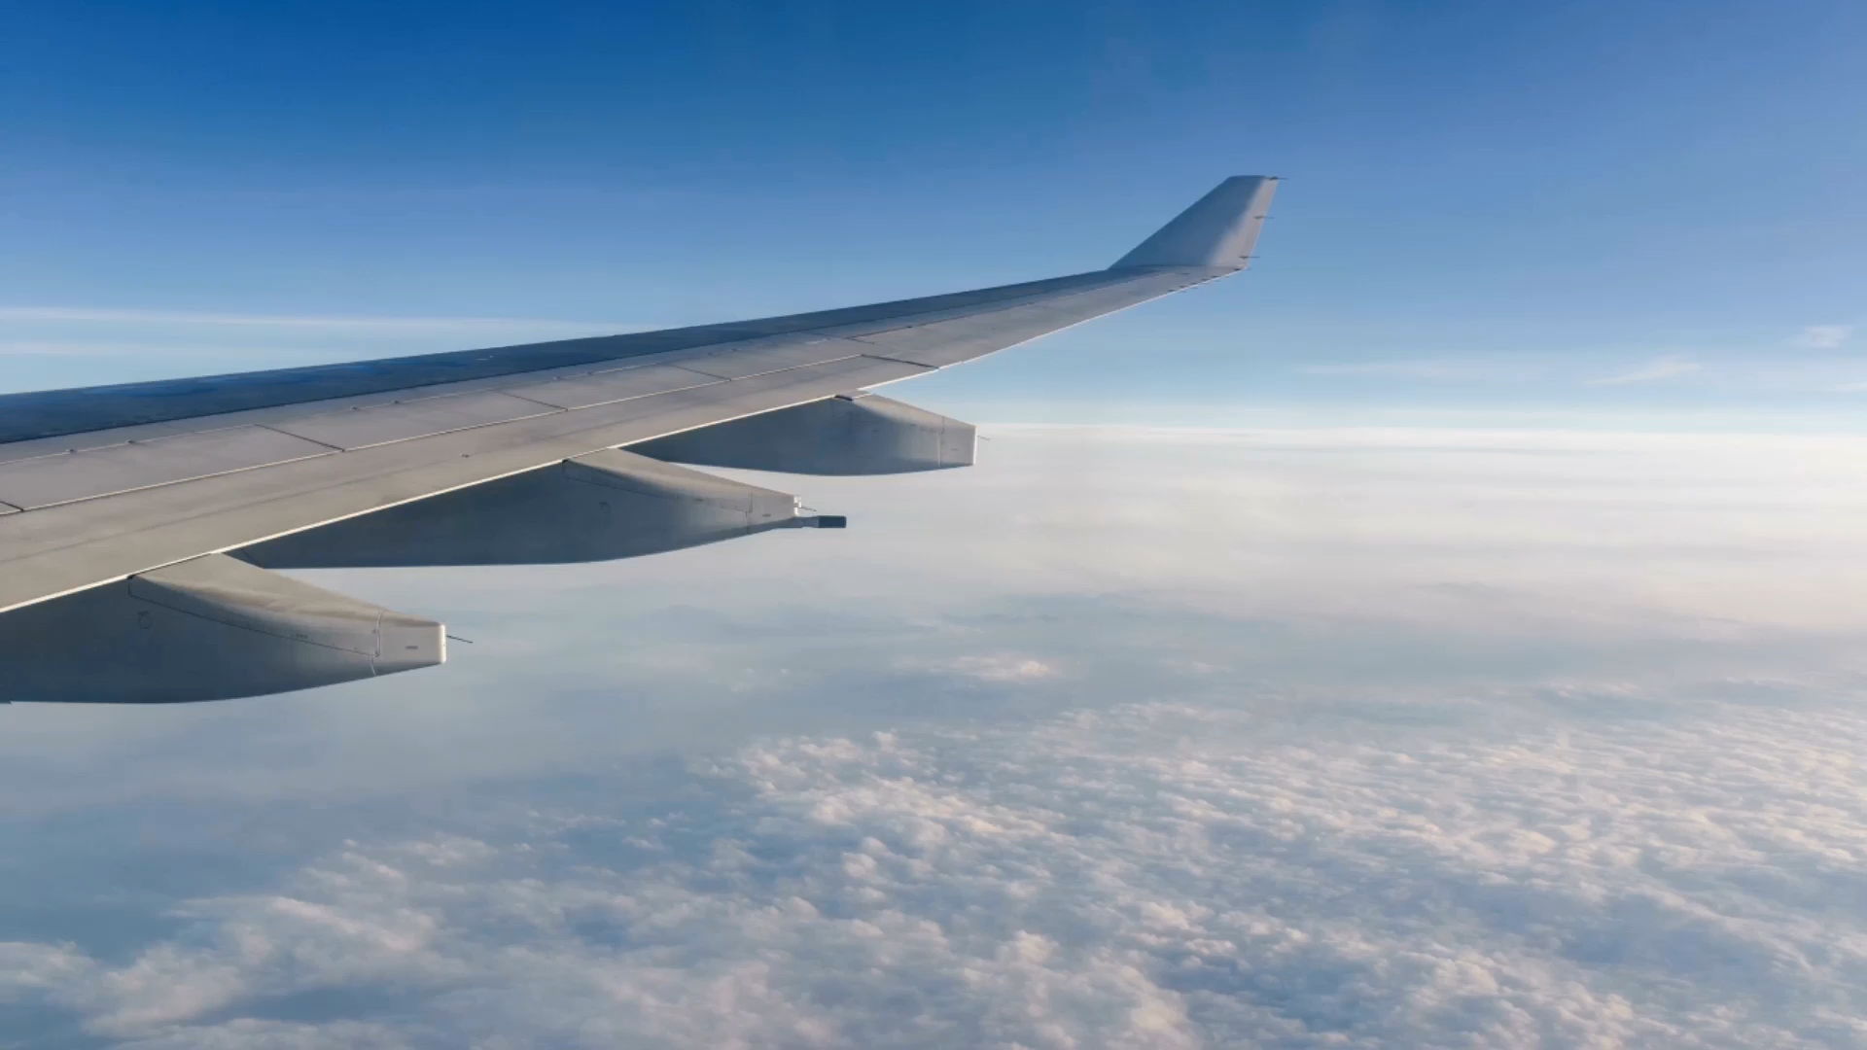
Flight Delays Prediction
By Rafaela and Zara

Slide 2
Introduction

Slide 3
EDA

Slide 4
Feature Engineering Process
There are several factors that can contribute to flight delays, and the reasons for delays can vary depending on the time of year, location, and other factors.
Most of the people believe that is due to the weather? Is there right? Is mostly about the weather?

Slide 5
Feature Engineering Process
Seasonality: Depending on the time of year, there may be seasonal patterns in flight delays. For example, the holiday season can be a busy time for travel, and delays may be more common during this time. Plotting the distribution of delays by month or quarter could help identify any seasonal trends.
Day of Week: Flight delays can also vary by day of the week, with some days experiencing more delays than others. For example, weekdays may have more delays due to the high volume of business travelers, while weekends may have fewer delays due to less congestion at airports. Plotting the distribution of delays by day of the week could help identify any weekly trends.

Slide 6
Feature Engineering Process
However, there are a few common reasons why June and July tend to be the months with the biggest flight delays:
Weather: June and July are peak summer months in many parts of the world, which means there is a higher likelihood of severe weather conditions that can disrupt flights. Thunderstorms, hurricanes, and other weather events can cause delays and cancellations.
Increased demand: Summer is a popular time for travel, with many people taking vacations and visiting family and friends. This increased demand for flights can lead to overbooking and congestion at airports, which can cause delays.
Maintenance issues: Airlines often schedule maintenance work on their planes during the slower winter months. As summer approaches and the number of flights increases, airlines may experience more mechanical issues with their planes, which can cause delays.
Air traffic congestion: With more people traveling during the summer months, there can be a higher volume of air traffic, which can lead to congestion at airports and delays in takeoff and landing times

Slide 7
Feature Engineering Process
Overall, while there may not be one single reason why June and July tend to be the months with the biggest flight delays, the combination of increased demand, weather-related disruptions, and other factors can all contribute to delays during these months.

Slide 8
Modelling

Slide 9
Machine Learning Model

